Slide 1
Python: A Versatile and Powerful Programming Language for Professionals

Slide 2

Slide
Title: Python: A Versatile and Powerful Programming Language for Professionals

Slide 3
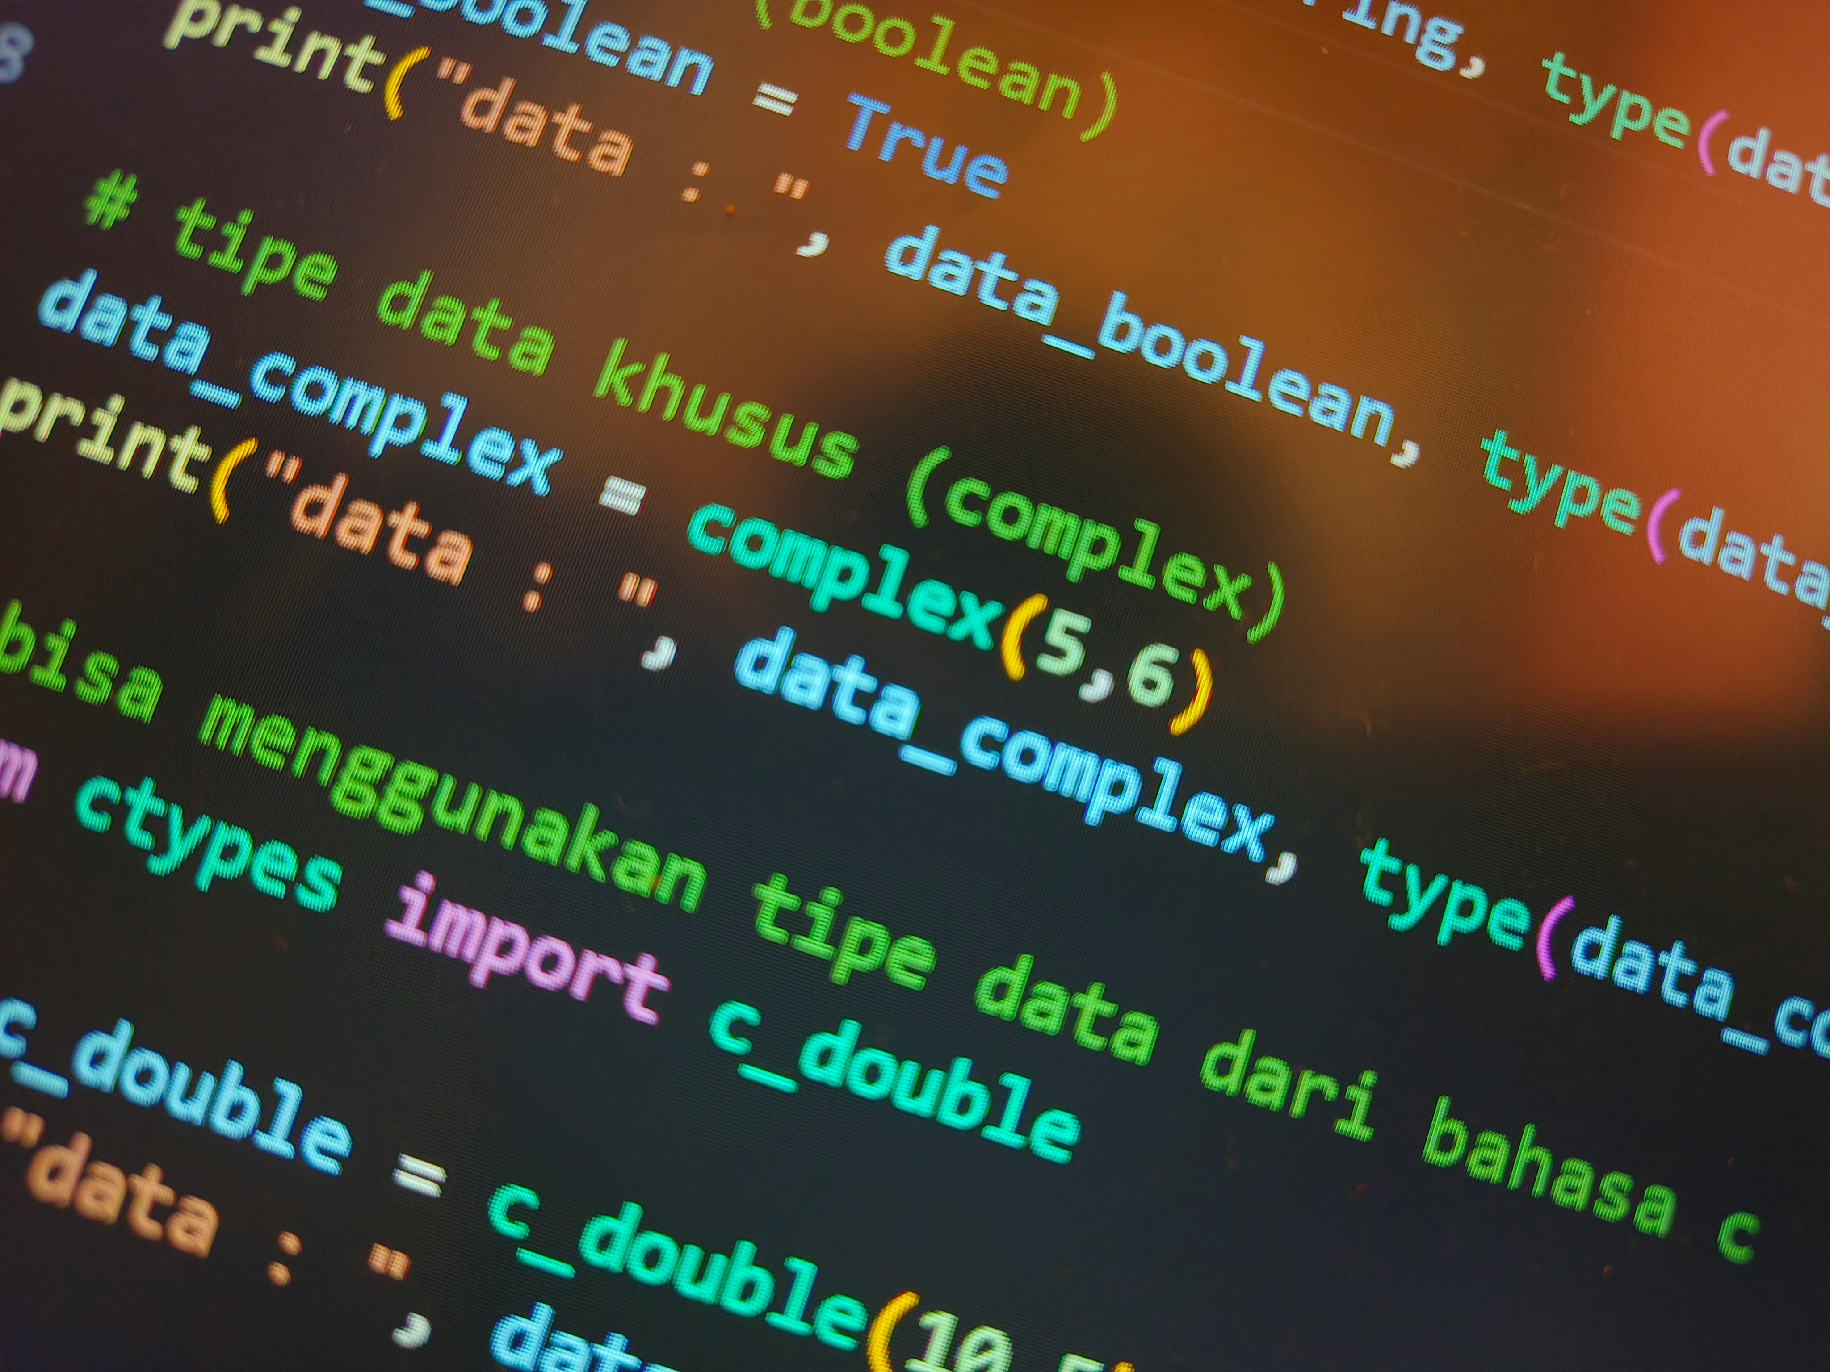
Introduction to Python
High-level, interpreted language
Readability and extensive libraries
Preferred for diverse professional applications

Slide 4

Development Simplicity
Dynamic typing simplifies development
Automatic memory management
Focus on problem-solving over low-level details

Slide 5

Clear Syntax and Maintainability
English-influenced syntax
Enhances code maintainability
Facilitates team collaboration

Slide 6

Robust Standard Library
Modules for web development
Modules for data science
Modules for system administration
Reduces need for external dependencies

Slide 7
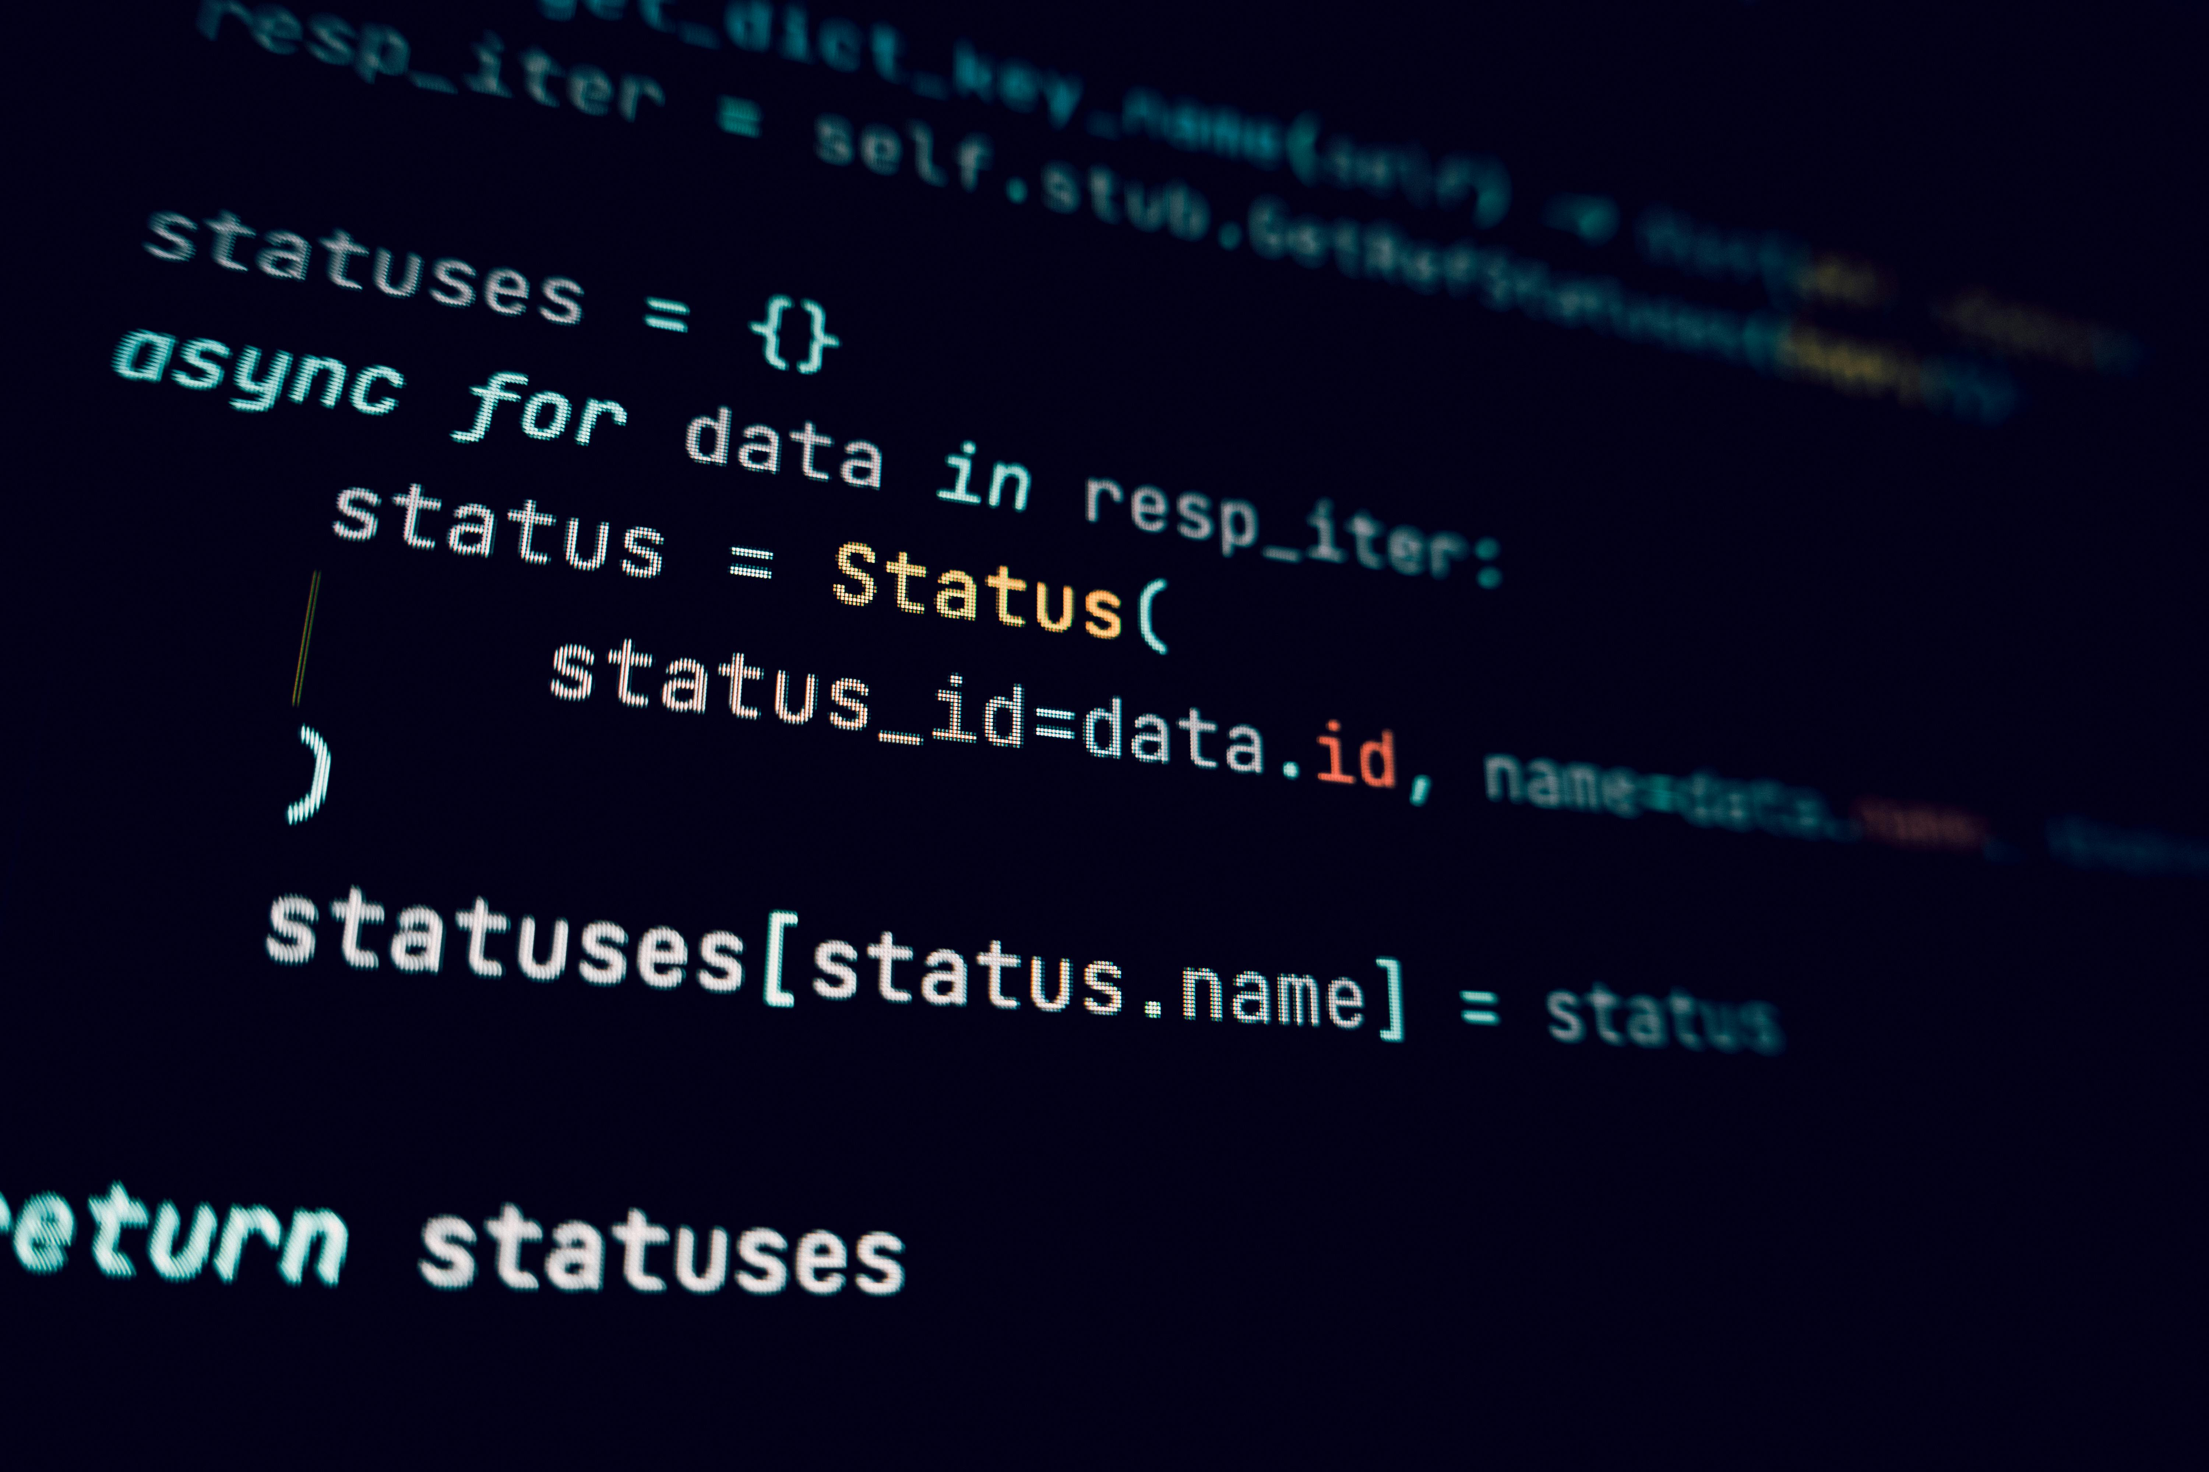
Object-Oriented Programming (OOP)
OOP support enables modular code
Promotes reusable code components
Efficient software design, reduced redundancy

Slide 8
Functional Programming Support
Supports functional programming paradigms
Concise, elegant solutions
Lambda functions, list comprehensions

Slide 9

High-Performance Computing
Integrates with C and C++
Leverage existing optimized code
Libraries for performance gains

Slide 10

Data Science Powerhouse
NumPy, pandas, scikit-learn, TensorFlow
Data analysis, manipulation
Machine learning, deep learning capabilities

Slide 11
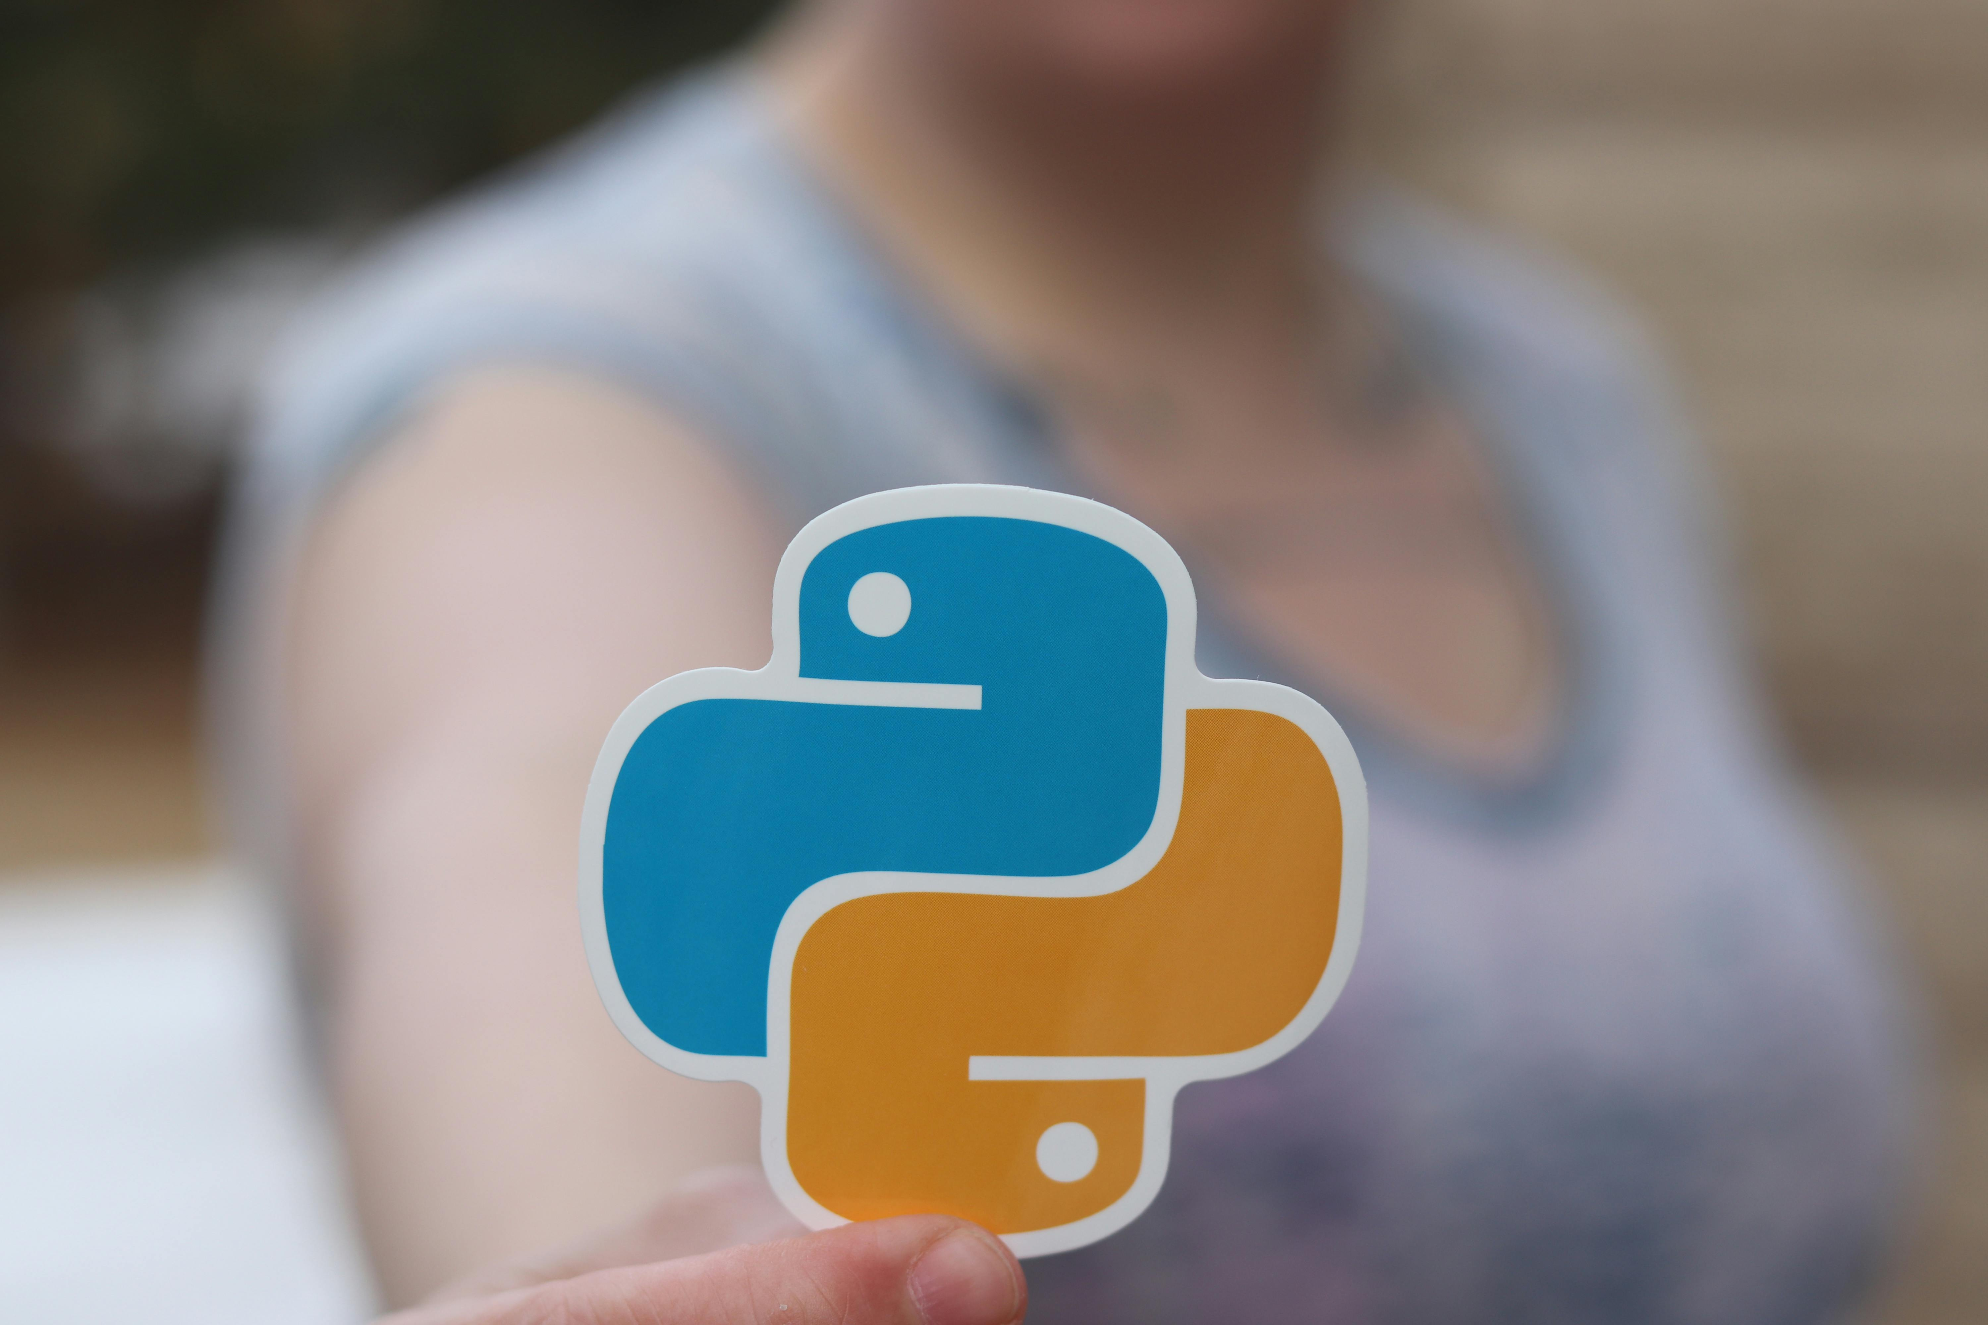
Web Development Frameworks
Django and Flask simplify web development
Routing, templating, database integration
Streamlines creation of scalable web solutions

Slide 12
Cross-Platform Compatibility
Code execution on various OS
Windows, macOS, Linux supported
Flexible choice for diverse environments

Slide 13
Python Package Index (PyPI)
Vast repository of third-party libraries
Readily available solutions
Extends language's capabilities significantly

Slide 14

Documentation and Community
Extensive documentation available
Vibrant and active community
Ample resources for learning and troubleshooting

Slide 15

Advanced Metaclasses
Advanced control over class creation
Customization of class behavior
Implementation of design patterns

Slide 16

Asynchronous Programming
`asyncio` for concurrent operations
Efficient handling of I/O-bound tasks
Improved responsiveness and scalability

Slide 17
Decorators
Concise way to modify function behavior
Code reuse and separation of concerns
Elegant implementation of cross-cutting concerns

Slide 18
Code Example
from dataclasses import dataclass
from typing import List
@dataclass(frozen=True)
class Product:
name: str
price: float
def calculate_total(products: List[Product]) -> float:
return sum(p.price for p in products)
if __name__ == '__main__':
products = [
Product("Laptop", 1200.00),
Product("Mouse", 25.00),
Product("Keyboard", 75.00)
]
total = calculate_total(products)
print(f"Total price: ${total:.2f}")

Slide 19
Code Example
from dataclasses import dataclass from typing import List @dataclass(frozen=True) class Product: name: str price: float def calculate_total(products: List[Product]) -> float: return sum(p.price for p in products) if __name__ == '__main__': products = [ Product("Laptop", 1200.00), Product("Mouse", 25.00), Product("Keyboard", 75.00) ] total = calculate_total(products) print(f"Total price: ${total:.2f}")

Slide 20
Code Example
from dataclasses import dataclass from typing import List @dataclass(frozen=True) class Product: name: str price: float def calculate_total(products: List[Product]) -> float: return sum(p.price for p in products) if __name__ == '__main__': products = [ Product("Laptop", 1200.00), Product("Mouse", 25.00), Product("Keyboard", 75.00) ] total = calculate_total(products) print(f"Total price: ${total:.2f}")

